Slide 1
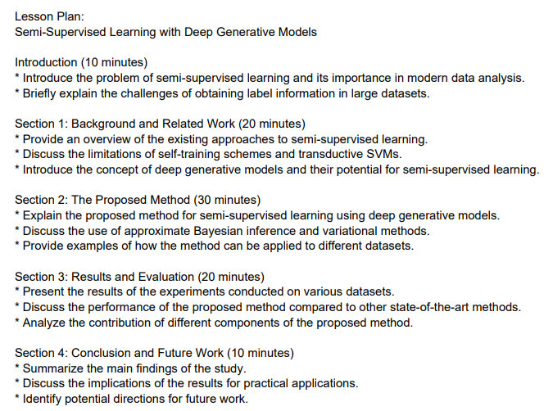
Multimedia Gen AI-Powered Course Module Generator
Eddie McGowan & Alex Kash
Lehigh University
Abstract
Data & Data Pipeline
This project introduces an AI-powered system that streamlines the creation of course modules by transforming teacher-provided resources such as PDFs, articles, and web links into structured, engaging lesson plans. Unlike commercial tools that rely solely on internal content, our solution empowers educators to guide the AI using their own materials and preferred formats.
The system integrates advanced text, image, and table extraction techniques (using PyMuPDF, BeautifulSoup, PDFPlumber, and Pillow) with a multimodal large language model (LLaVA) to generate coherent, media-rich lessons. A user-friendly interface enables educators to review, approve, or refine content interactively. Finalized modules are published to a dynamic website, enabling real-time updates and student access.
By supporting multimedia inputs and delivering outputs directly to the web, this solution reduces lesson planning time while enhancing personalization and instructional quality. This tool is designed with educators in mind, promoting greater control over AI-driven content and fostering deeper student engagement.
Key Features:
Accepts multimedia inputs (text, images, tables)
Editable prompt interface for teachers
“Reprompt”/“Approve” workflow for lesson refinement
Automatic website deployment for student access
BRIEF DESCRIPTION OF DATASET AND DATA SOURCE
INPUTS
PROCESSING
OUTPUT
LLAVA Pretrained Context
Overall
PDF and Web Documents (Lesson Plans, Resources)
Text, Image, Table, Extraction and Preprocessing
LLAVA Model Creates Lesson Plan
Lesson is Saved in a JSON Format
Lesson Plan is Published on Website using Flask
Initial Prompt by Teacher
Teacher can re-prompt model to adjust lesson plan content
FEEDBACK
LOOP
INPUTS
Extract Text Content using PyMuPDF
PROCESSING
OUTPUT TO MODEL
PDF Content Provided by Teacher
Extract Table Content Using PDFPulmber
Convert each table to markdown format for tokenization
Problem Description & Motivation
Content
Extraction
Extract Image Content Using PDFPulmber & Pillow
Combined Document Context
Lesson planning is a time-consuming task, especially when educators aim to tailor instruction to specific learning goals or student needs. While commercial AI tools exist, they rarely allow teachers to control inputs or personalize content. This project builds a solution that empowers educators to generate structured course modules using their own resources.
Our solution system allows teachers to upload PDFs, articles, and web links, and automatically transforms them into structured lessons. The system integrates a multimodal AI model (LLaMA) capable of processing text, and tables. The final output is a media-rich Streamlit module that can be published to a custom website and updated based on teacher feedback. If productionized, this model can be integrated with learning management systems such as Course Site or Canvas.
1
Extract Text & Image Content Using BeautifulSoup
Web Conent Provided by Teacher
Extract Table Content Using BeautifulSoup
Convert each table to markdown format for tokenization
Evaluation
Model Selection
Tools Utilized:
Resource Input: PDFs, articles, and web links
Extraction Tools: PyMuPDF (text), PDFPlumber & Pillow (images/tables), BeautifulSoup (web scraping)
Model Backend: Llama-2-7b-chat-hf (multimodal LLM)
Frontend: Streamlit interface for lesson generation hosted on lehigh magic-02 high performance computer
Models Tested:
LLaVA 1.5: Accepts images, text, and tables. Poor at summarizing text
LLaVA 1.6: Accepts images, text, and tables. Cannot be configured on Magic-02
OpenAI GPT-4o: Accepts images, text, and tables. Requires paid subscription for unlimited access
Llama-2-7b-chat-hf (Chosen Model): Accepts, text, and tables. Excels at summarizing text. Does not accept image inputs
Comparison With Existing Tools
Sample Workflow
Teacher uploads a PDF and edits a default lesson prompt.
AI extracts text, tables, and images.
Lesson is generated and previewed.
Teacher selects “Reprompt” or “Approve.”
Final version is deployed to the class website.
A sample lesson plan output from the Model.
Conclusion
This tool empowers educators with a fast, flexible lesson planning workflow. It supports multimodal materials and reduces iteration cycles by incorporating teacher feedback in real-time. Students benefit from more personalized and engaging learning modules.
Feature | This Project | Khanmigo (Khan Academy)
Teacher Defined Sources | ✅ | ❌
Media Extraction (PDF/Web) | ✅ | ❌
Web Publishing | ✅ | ❌
Feedback-based revision | ✅ | ❌
Future world
Link with educational platform (e.g., Lehigh Course Site)
Deploy on cloud infrastructure for scalability
Change the backend model to LLaVA 1.6 to support image inputs
Accept video inputs
Preload state and national educational requirements to ensure lesson plans meet educational benchmarks
Acknowledgements
Masoud Yari
Todd George

